Slide 1

Sir M.Visvesvaraya Institute Of Technology
Department of Computer Science & Engineering
PROJECT DEMO
“Intelligent Autonomous Game Bots using Deep Q Reinforcement Learning”
Team Members: 1. Adarsh Trivedi 1MV13CS004
2. Aditya Roy Choudhary 1MV13CS005
3. Amit Asish Bhadra 1MV13CS014
4. Karan Saxena 1MV13CS047
Guide: Prof. Dilip K. Sen

Slide 2
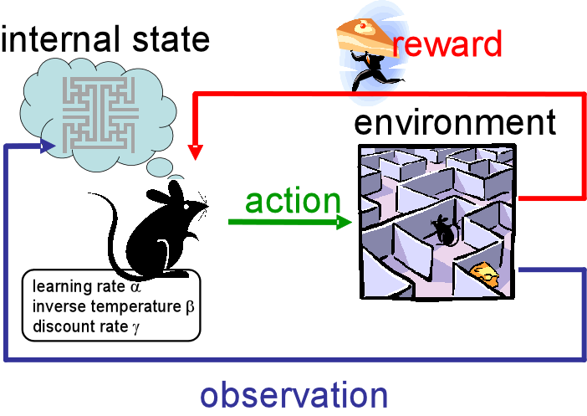
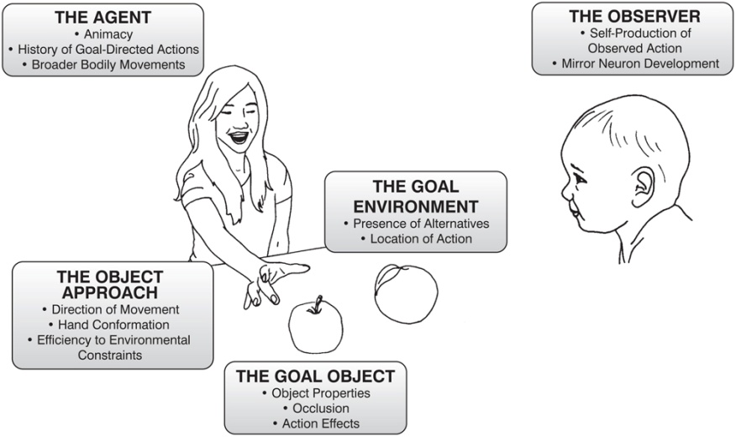
Introduction
Learning goal-directed behaviour
Reinforcement learning (RL)
Reinforcement learning is a type of Machine Learning algorithms which allows software agents and machines to automatically determine the ideal behaviour within a specific context, to maximize its performance.
The objective is to develop a framework with organized deep reinforcement learning modules working at an environment agnostic level.
Notes:
Most Simple definition of AI: Any program which executes to solve a problem
Unlike most other programs, which basically execute instructions.
2

Slide 3
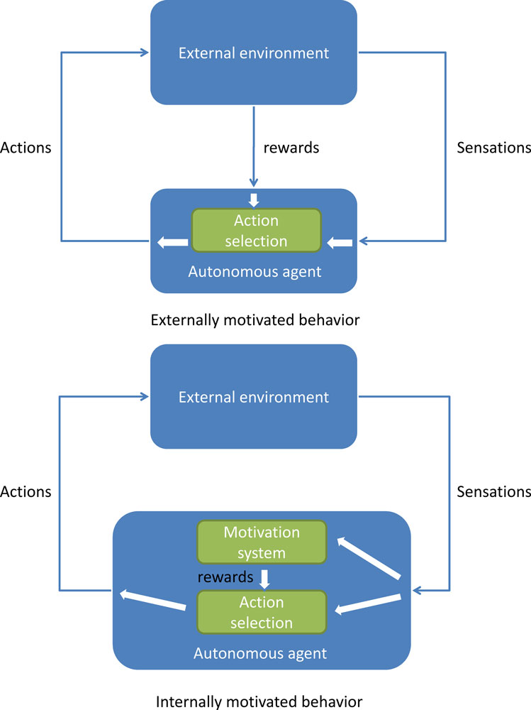
Abstract
Intrinsically motivated agents can explore new behaviour for its own sake rather than to directly solve problems. Such intrinsic behaviours could eventually help the agent solve tasks posed by the environment.
A top-level value function learns a policy over intrinsic goals, and a lower-level function learns a policy over atomic actions to satisfy the given goals.
Parallel-DQN allows for the tradeoff between exploration vs exploitation by allowing parallel agents to modify the global network SIMULTANEOUSLY.
This provides an efficient space for exploration in complicated environments.

Slide 4
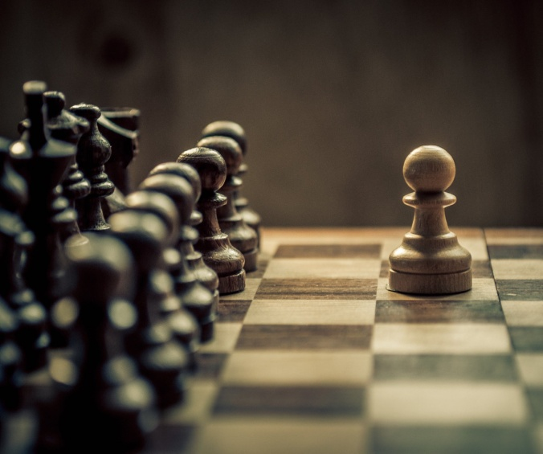
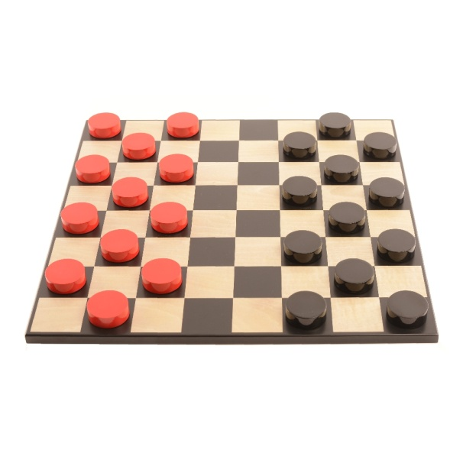
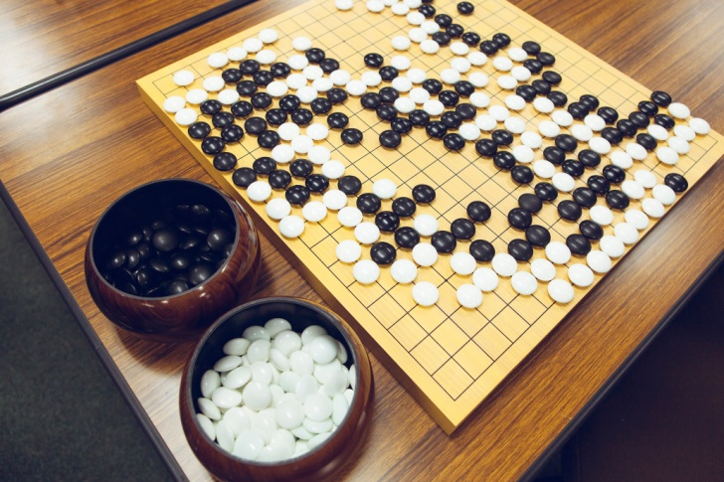

Teaching AI to play games can be used to measure how smart an AI actually is!
A narrow AI developed by DeepMind which beat the World Champion Lee Sudol in March 2016.
Notes:
Earlier board games could be taught to beat using pure brute force crunching large number of moves,
but games like Go can’t be solved that way, they are learnt by the machines to play via heuristics.
Alpha Go uses deep neural network (looks for patterns) Alpha GO has 48 layers of neurons.
(it mimics human intuition and creativity).
4

Slide 5
Basic Theory
Q Learning: In it’s simplest implementation, Q-Learning is a table of values for every state (row) and action (column) possible in the environment.
Eq 1. Q(s,a) = r + γ(max(Q(s’,a’))
Policy Learning: We learn which rewards we get for each of the possible actions, and ensuring we chose the optimal ones.
Value Learning: Instead of learning the optimal action in a given state, the agent learns to predict how good a given state or action will be for the agent to be in.
Notes:
In the first segment we handle parameters which are common throughout all the games running in the Atari environment,
Simulator segment is used to define the part of the model which handles the objects related to the different simulators individually catering to the environment of the specific game
the train-Atari segment is the part of our model which is actually involved with the training process where the machine learns to play the game.
5

Slide 6
Basic Theory
Policy Gradient: We arm the agent with an e-greedy policy. This means that most of the time our agent will choose the action that corresponds to the largest expected value, but occasionally, with e probability, it will choose randomly.
MDP: Given a state action pair (s, a), the transition probability to a new state s’ is defined by T(s, a), and the reward r is given by R(s, a)
MDP is to CNN ; as POMDP is to RNN.
Different actions yield different rewards. Rewards are delayed over time. Reward for an action is conditional on the state of the environment.
Notes:
In the first segment we handle parameters which are common throughout all the games running in the Atari environment,
Simulator segment is used to define the part of the model which handles the objects related to the different simulators individually catering to the environment of the specific game
the train-Atari segment is the part of our model which is actually involved with the training process where the machine learns to play the game.
6

Slide 7
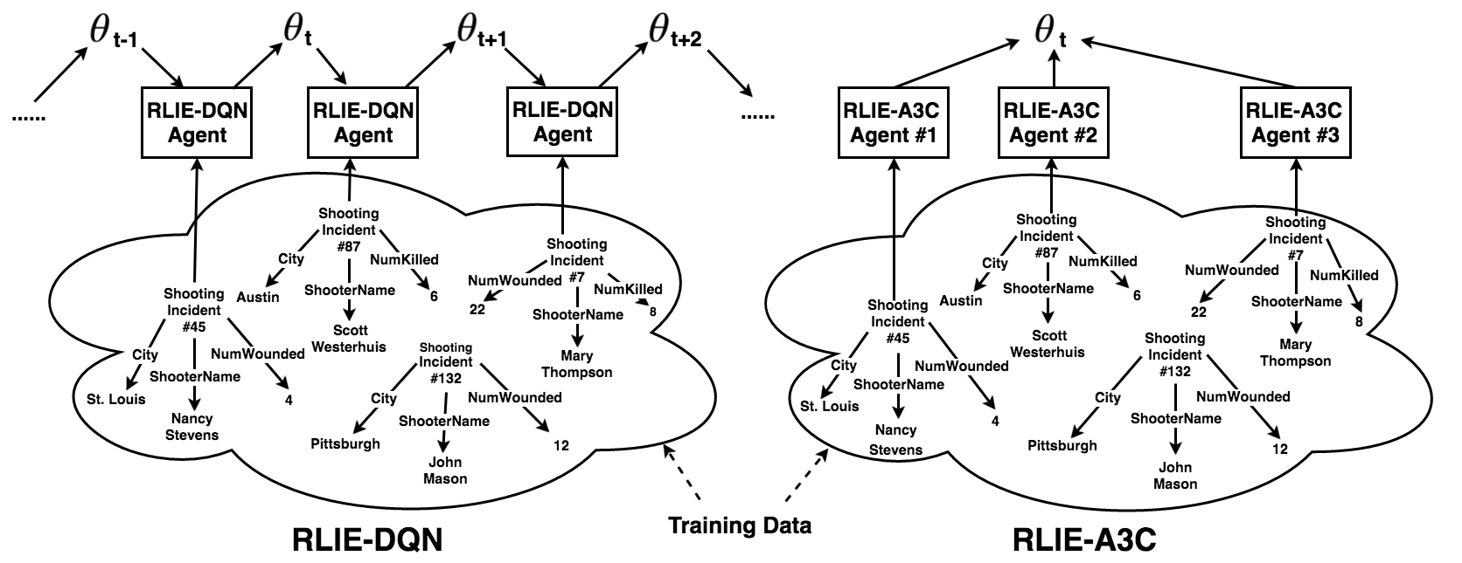
Control Flow Diagram & Data Flow Diagram

Slide 8
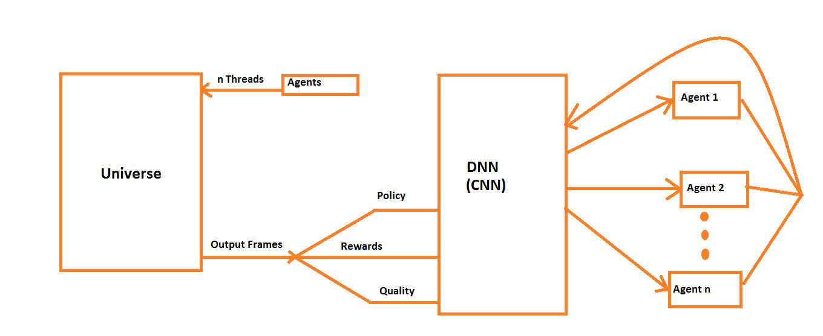
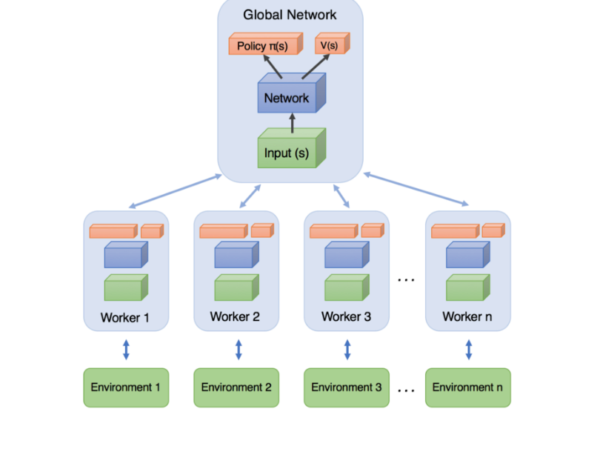
Control Flow Diagram & Data Flow Diagram

Slide 9



This project is developed using a combination of Tensor Flow and OpenAI Gym to create an simulate an environment in which runs and plays the trained models of Atari Games.
Notes:
TensorFlow is an open source software library for machine learning across a range of tasks, and developed by Google to meet their needs for systems capable of building and training neural networks to detect and decipher patterns and correlations, analogous to the learning and reasoning which humans use.
OpenAI is a non-profit artificial intelligence (AI) research company, associated with business magnate Elon Musk, that aims to carefully promote and develop friendly AI in such a way as to benefit humanity as a whole.
9

Slide 10
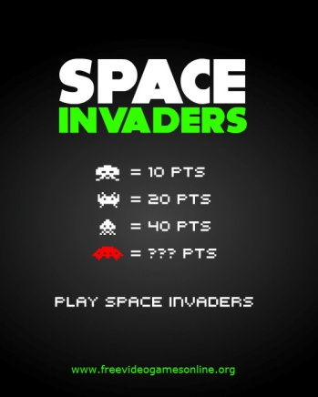

Implementation
The code for our model has been divided into three segments namely Common, Simulator, and Train-atari.
Notes:
In the first segment we handle parameters which are common throughout all the games running in the Atari environment,
Simulator segment is used to define the part of the model which handles the objects related to the different simulators individually catering to the environment of the specific game
the train-Atari segment is the part of our model which is actually involved with the training process where the machine learns to play the game.
10

Slide 11
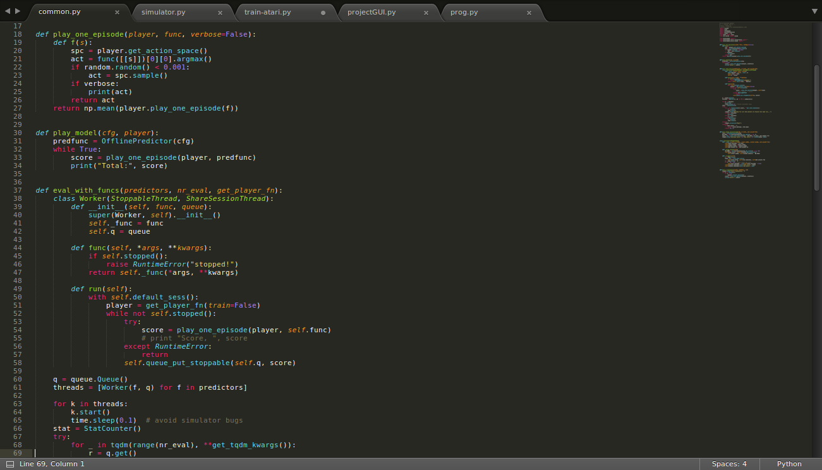
Code Snippet for Common.py

Slide 12
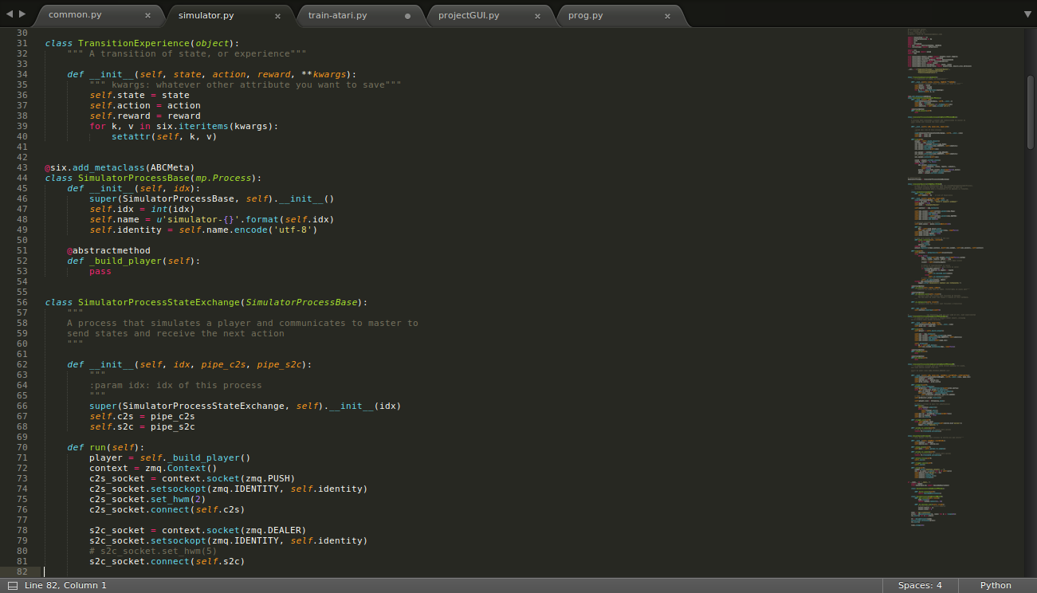
Code Snippet for Simulator.py

Slide 13
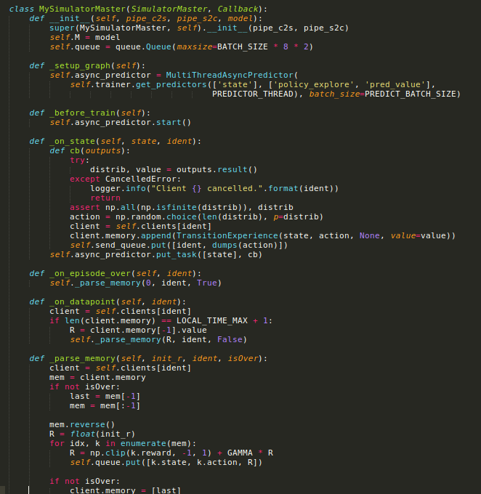
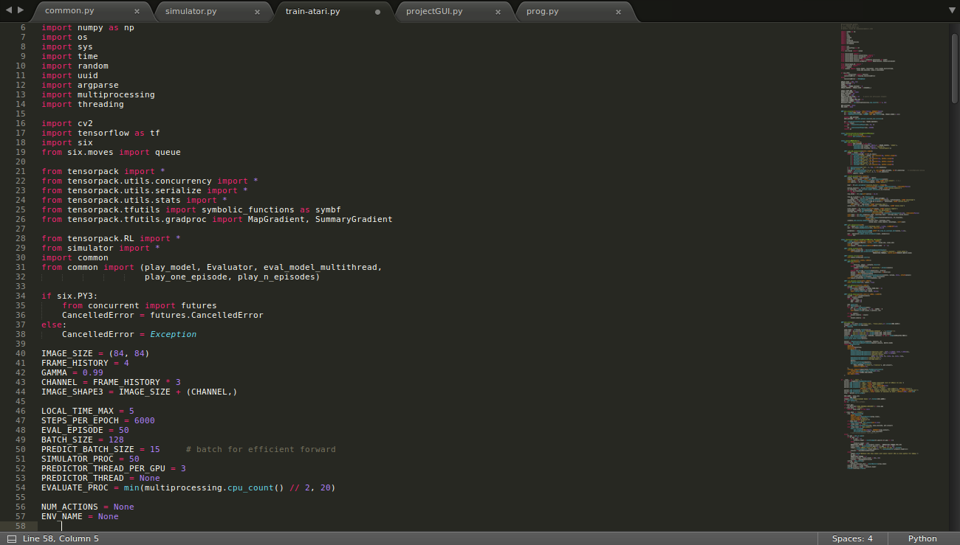
Code Snippet for train-atari.py

Slide 14
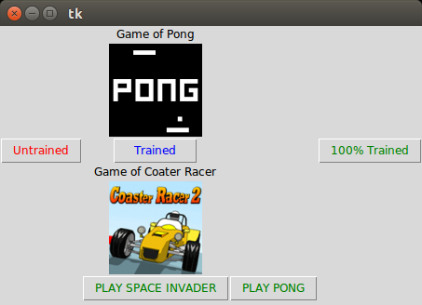
Execution & Test Cases
Snapshot of the GUI (under development)

Slide 15
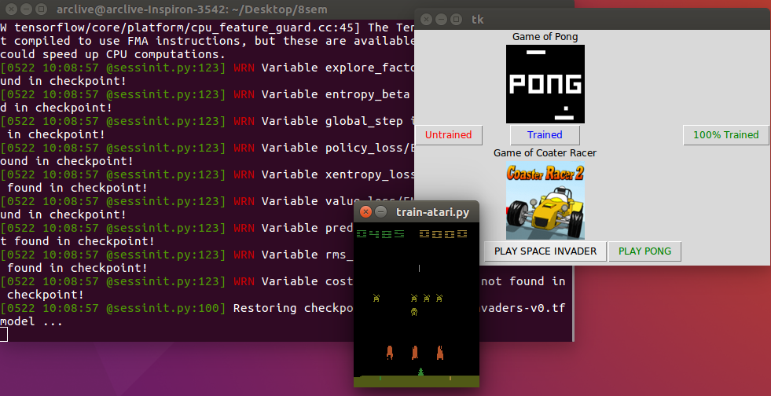
Snap of the final testing phase of the Space Invader Game.

Slide 16
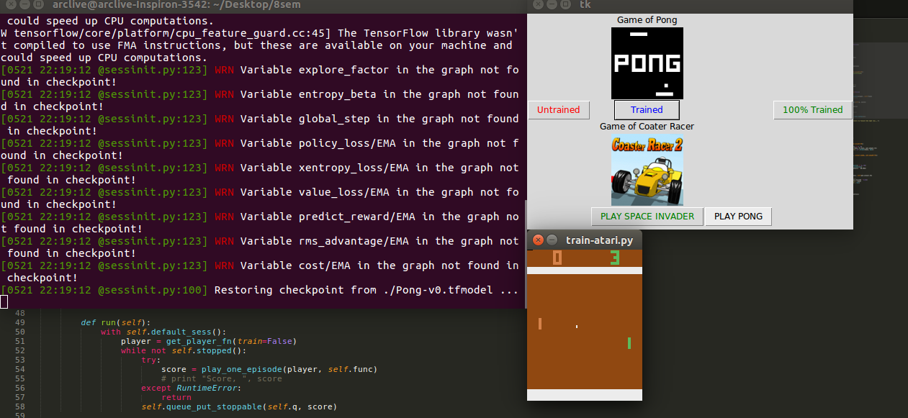
Snap of the final testing phase of the Pong Game.

Slide 17
Uses
-- Robotics
-- Finance Sector
-- Medical Sector (Eg. Amblyopia)

Slide 18
THANK YOU!

